Slide 1
Customer Churn Prediction
Surya vamsi Patiballa

Slide 2

The Problem Statement…
Our fascinating motto is to predict the root causes / main reasons of the CUSTOMER EXIT (Churn) from one telecom industry and entry to other industries.
The factors that strongly impact the subscriber’s exit will be found in our whole project journey using Data Visualization and Machine Learning Modeling Algorithms. So, “Churn” is our Target / Dependent feature for our project work flow.

Slide 3
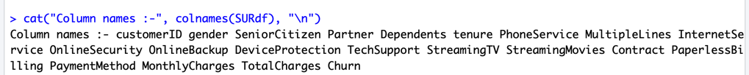
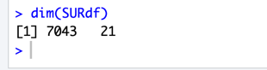
Anatomy of our Data Set
Dimensions of Data Set
Features of Data Set
Our Data set consists of “7043” rows and “21” columns / features. Kaggle is our data source.

Slide 4
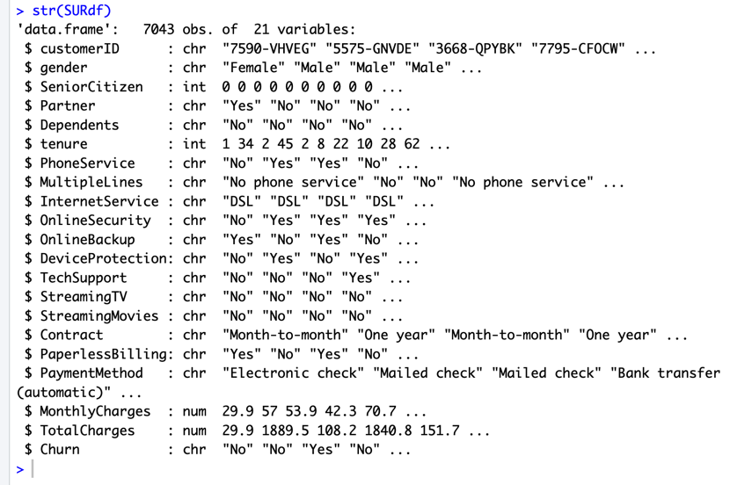
STRUCTURE of our Data Set

Slide 5
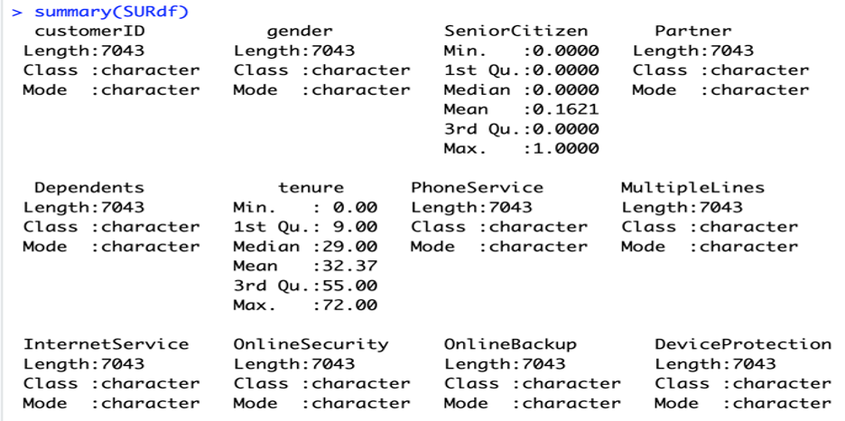
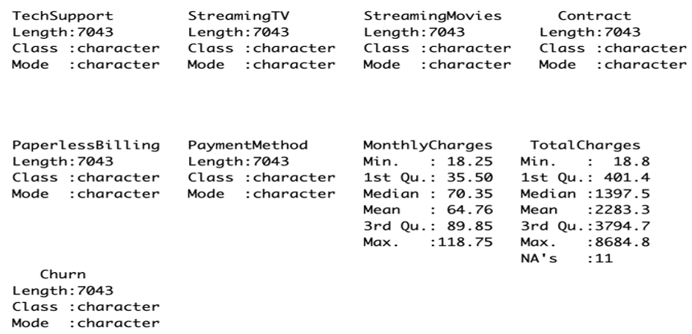
SUMMARY of our Data Set

Slide 6

STAGE - 1

Slide 7
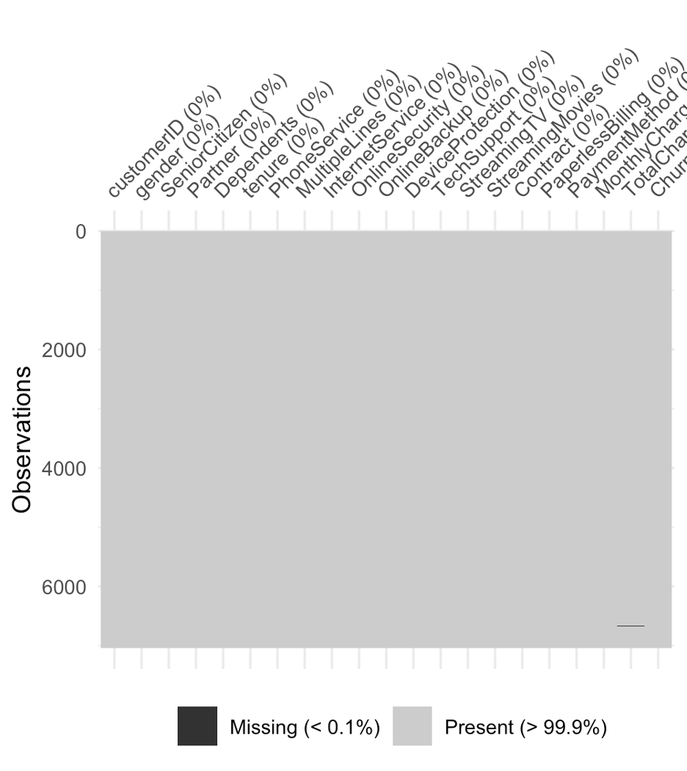
Rough / Indirect check of Missing Values
The dataset has no significant missing values across any columns. The "Missing (< 0.1%)" section confirms negligible missing data.
Data quality is excellent, and no imputation or handling of missing values is required before proceeding with analysis

Slide 8
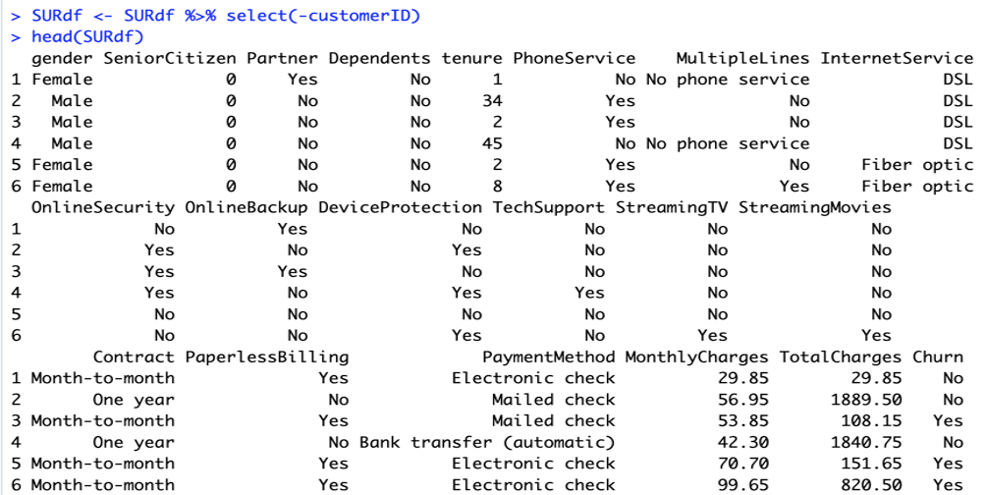
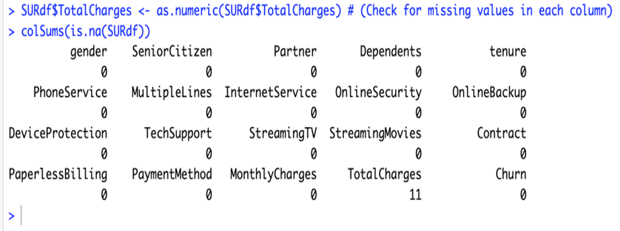
We dropped “customerID” column
Checked Missing Values count
We found 11 missing values in TotalCharges.

Slide 9
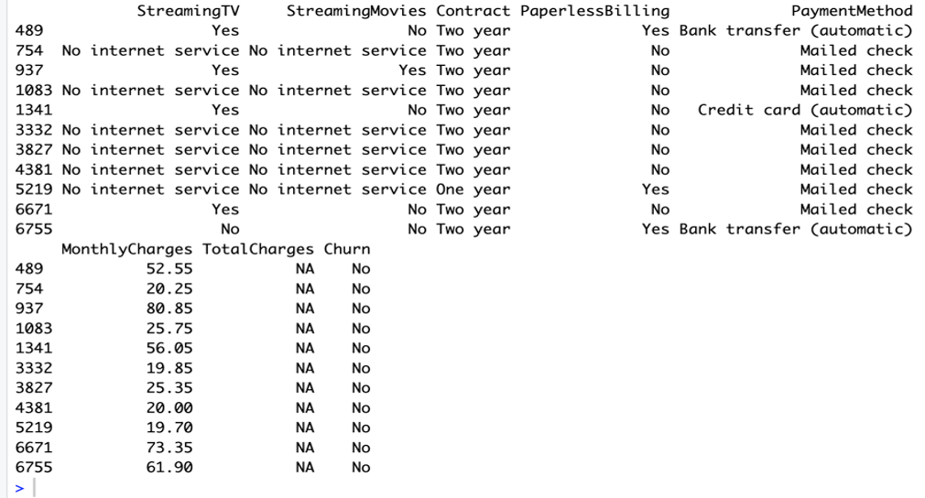
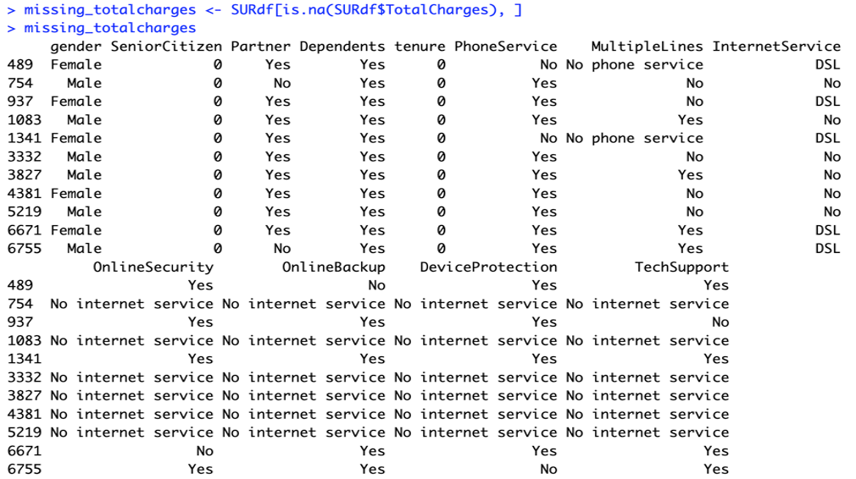
Filtering rows where ‘TotalCharges’ is NA and Viewing rows with missing ‘TotalCharges’
It can also be noted that the Tenure column is 0 for these entries even though the MonthlyCharges column is not empty. Let's see if there are any other 0 values in the tenure column.

Slide 10
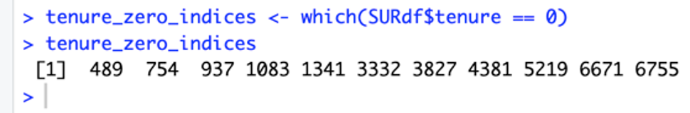
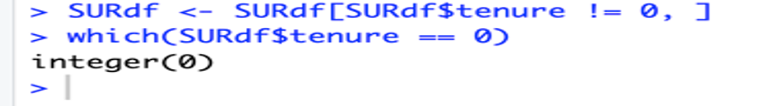
Get the indices of rows where 'tenure' is equal to 0
There are no additional missing values in the Tenure column. Let's delete the rows with missing values in Tenure columns since there are only 11 rows and deleting them will not affect the data.
Drop rows where 'tenure' is equal to 0

Slide 11
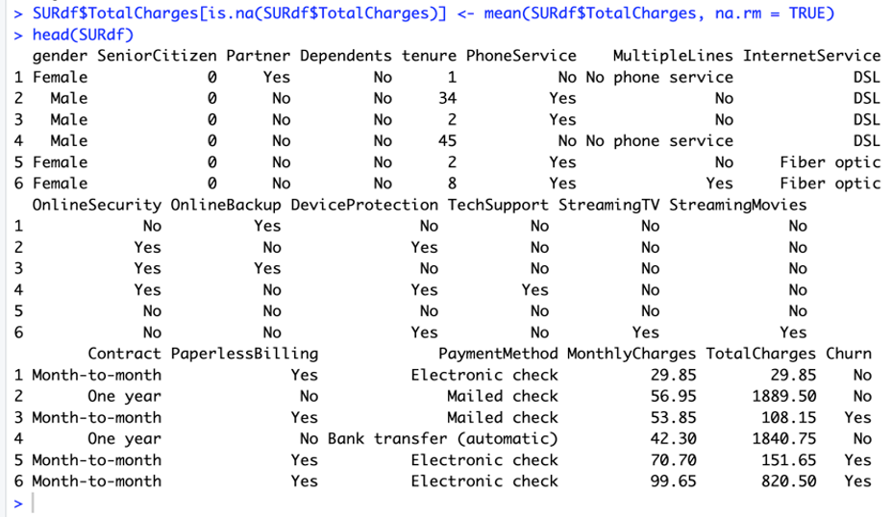
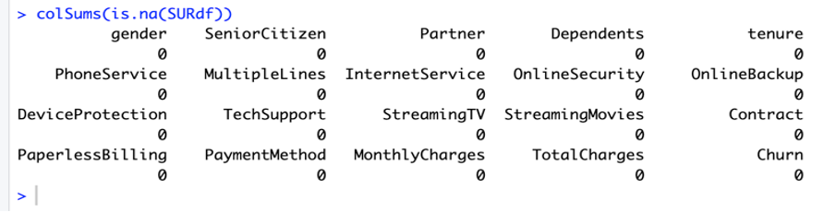
To solve the problem of missing values in TotalCharges column, I decided to fill it with the mean of TotalCharges values.
Count the number of missing values (NA) in each column
Finally there are no missing values in all features.

Slide 12
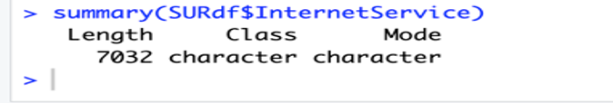
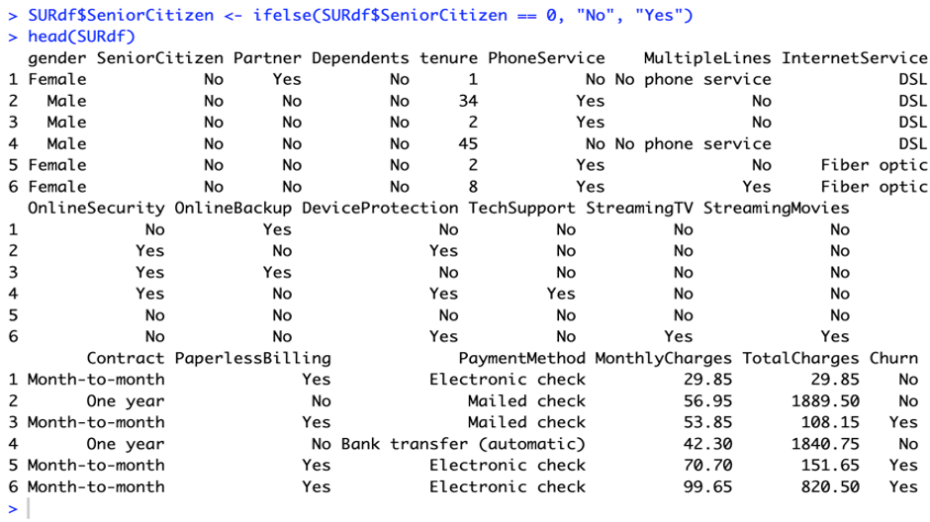
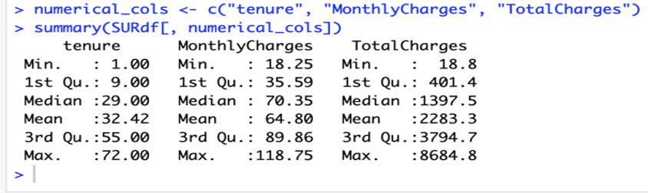
Map values in the 'SeniorCitizen' column: 0 -> "No", 1 -> "Yes”
Summarize the 'InternetService' column
Summarize the specified numerical columns
Tenure, monthly charges, and total charges are critical numerical variables for customer churn prediction.
The variability in total charges suggests diverse customer engagement and payment patterns.

Slide 13

STAGE - 2

Slide 14
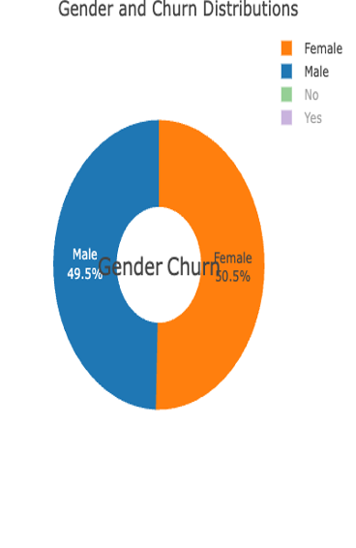
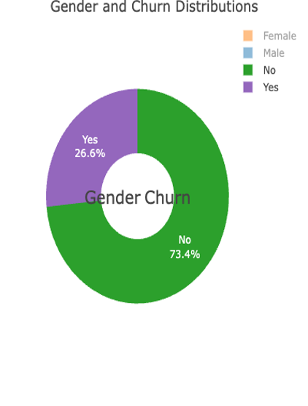
Gender and Churn Distributions
Customers who exited consisted of 49.5 % female and 50.5 % male.
Among the whole, 26.6 % of customers switched from one firm to another firm.

Slide 15
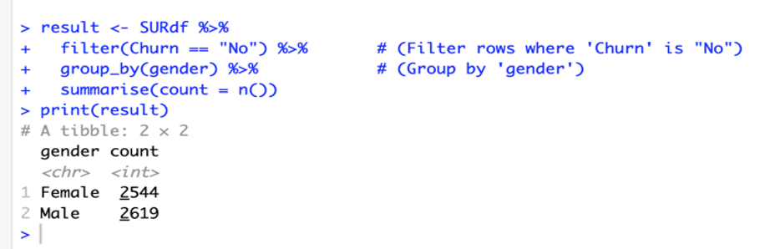
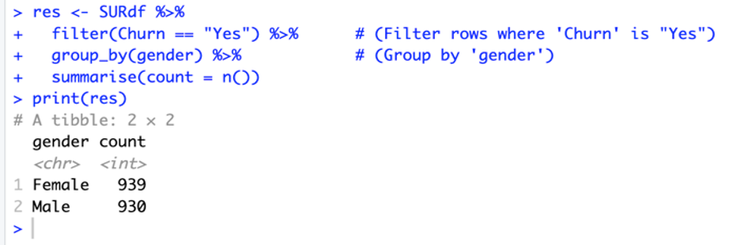
Gender count where Churn is “NO”
Here, the male customers exit count is less.
Gender count where churn is “YES”
The female exit is more and should be noted down.

Slide 16
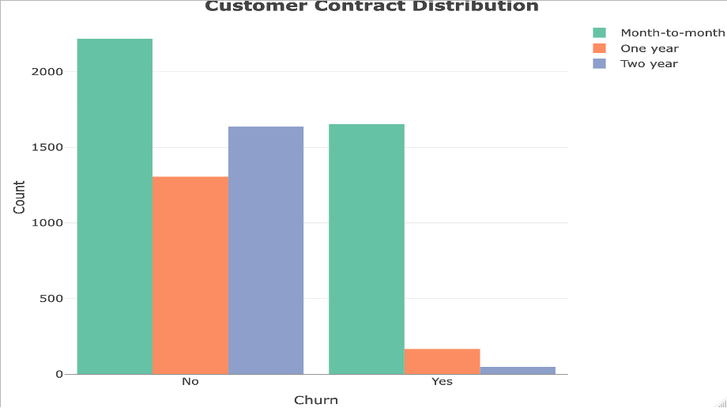
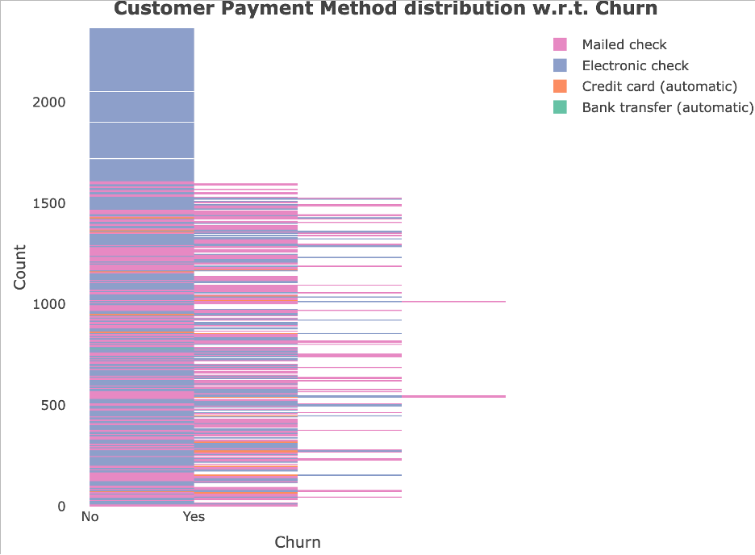
Impact of Contract type on Churn
Impact of Payment method on Churn
A majority of customers who churn are on month-to-month contracts, highlighting their higher likelihood of leaving.
Customers with longer contracts (one or two years) have significantly lower churn rates, indicating contract duration is a stabilizing factor.
Contract type is a strong predictor of churn, and encouraging customers to adopt long-term contracts may reduce churn.
Customers using Electronic Check as their payment method have the highest churn rate, indicating potential dissatisfaction with this method.
Payment methods like Credit Card (automatic) and Bank Transfer (automatic) are associated with significantly lower churn rates, showing they help retain customers.
Encouraging customers to switch to automatic payment methods can potentially reduce churn.

Slide 17
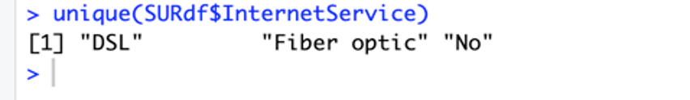
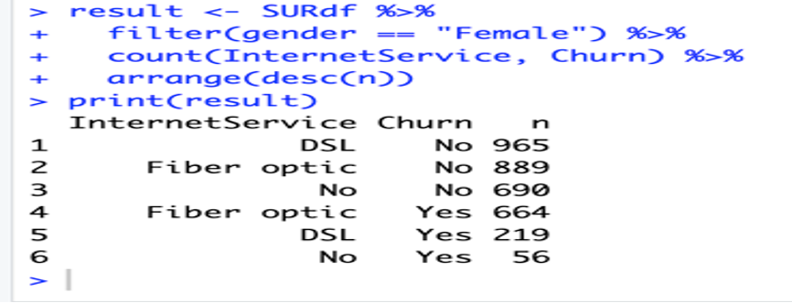
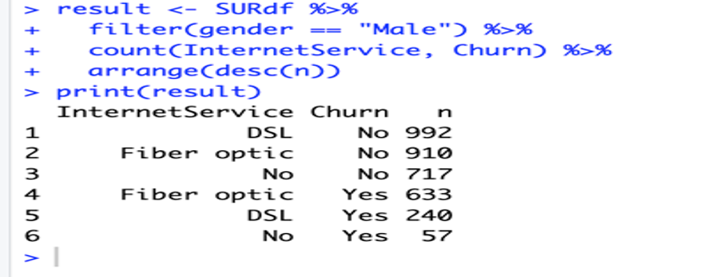
Get unique values from the 'InternetService' column
Filter rows where gender is "Male" and count combinations of InternetService and Churn
Filter rows where gender is ”Female" and count combinations of InternetService and Churn

Slide 18
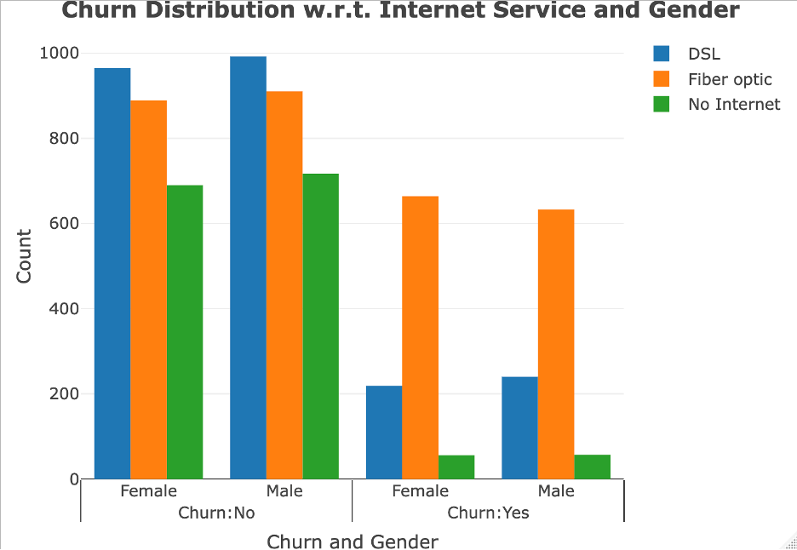
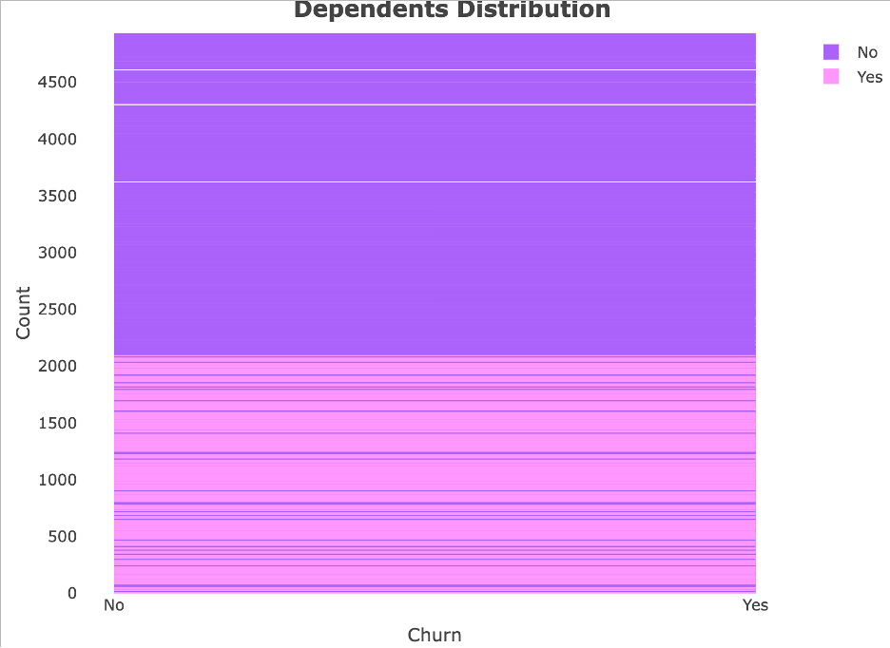
Impact of Internet Service on Churn Across Genders
Both males and females with Fiber Optic service show the highest churn rates, indicating potential dissatisfaction with this type of internet service.
DSL users, irrespective of gender, have significantly lower churn rates, indicating it is a preferred and stable service.
The type of Internet service is a critical driver of churn, with Fiber Optic users exhibiting the highest churn rates. Improving the quality or affordability of Fiber Optic service could significantly reduce overall churn. Gender does not play a significant role in churn behavior.
Dependents and Churn Behavior
Customers without dependents ("No") have significantly higher churn rates compared to those with dependents ("Yes")
Customers with dependents are more likely to stay, suggesting dependents could indicate stability or commitment to the service.
Customers without dependents are more likely to churn. Tailored retention strategies targeting this group, such as flexible plans or incentives, could reduce overall churn.

Slide 19
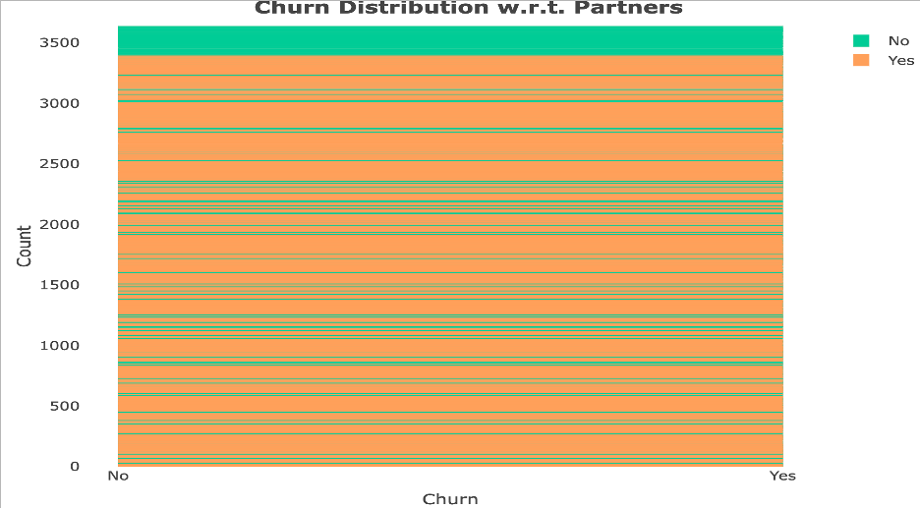
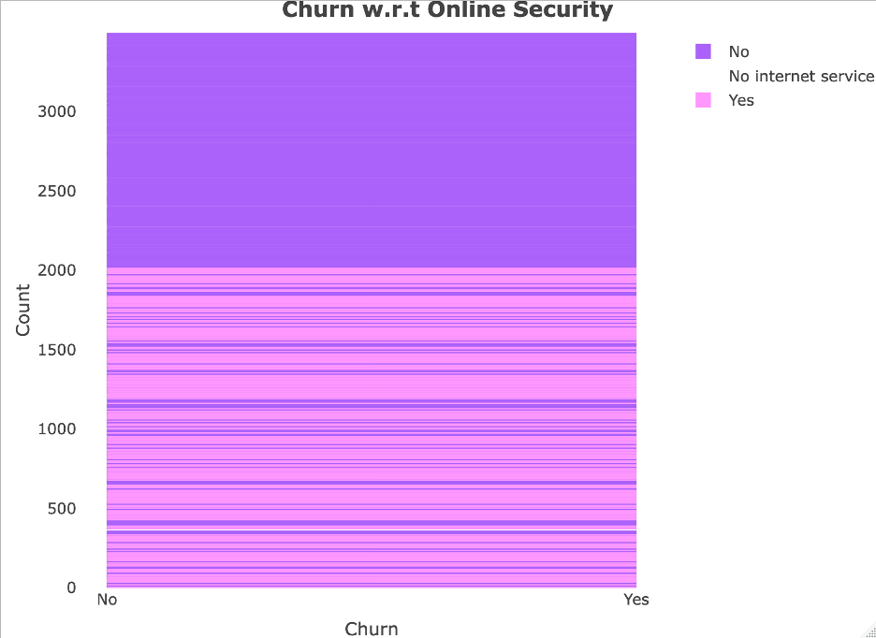
Partner Status and Churn Behavior
Customers without partners ("No") exhibit higher churn rates compared to those with partners ("Yes")
Customers with partners are more likely to stay, indicating they may have more stability or loyalty towards the service
Customers without partners are at a higher risk of churn. Offering personalized plans or retention incentives targeted at these customers may help improve retention rates.
Impact of Online Security on Churn
Customers who do not have Online Security services ("No") have significantly higher churn rates, indicating a potential dissatisfaction or perceived lack of value.
Customers with Online Security ("Yes") are less likely to churn, highlighting it as a retention-enhancing feature.
Providing or promoting Online Security services can reduce churn, as customers with this feature tend to stay longer. Targeted campaigns to upsell this service could improve retention.

Slide 20
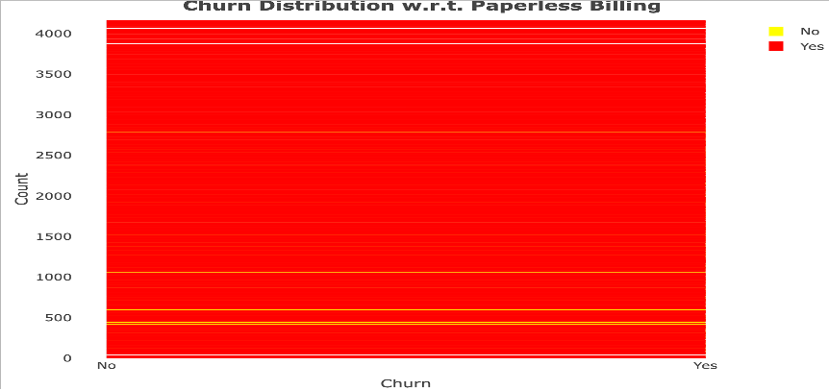
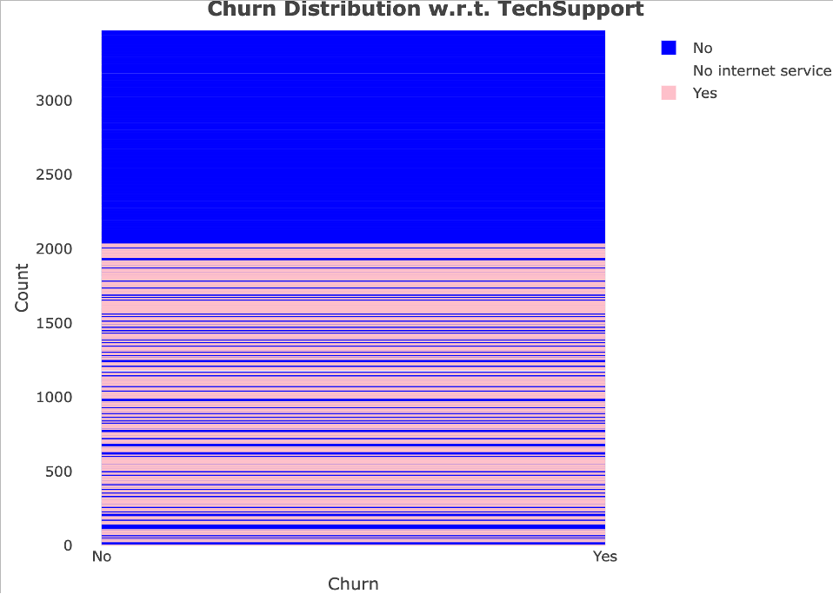
Impact of Paperless Billing on Churn
Customers who use Paperless Billing exhibit significantly higher churn rates compared to those who do not use this option.
Customers who opt for traditional billing methods ("No") have a much lower likelihood of churning, indicating a preference for conventional billing among loyal customers.
Paperless Billing is associated with higher churn rates. To reduce churn, improving the customer experience or addressing potential dissatisfaction related to Paperless Billing is crucial. Offering hybrid or customized billing solutions could help retain these customers.
Role of Tech Support in Reducing Churn
Customers who do not have Tech Support ("No") show significantly higher churn rates, indicating a lack of support may lead to dissatisfaction.
Customers with Tech Support ("Yes") are much less likely to churn, showcasing its positive impact on retention.
Tech Support availability plays a crucial role in reducing churn. Encouraging customers to subscribe to Tech Support or bundling it with other services could improve customer satisfaction and retention.

Slide 21
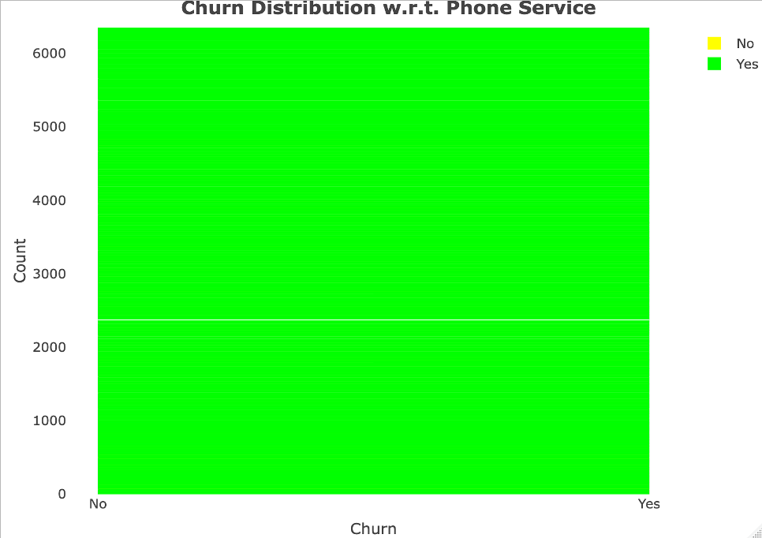
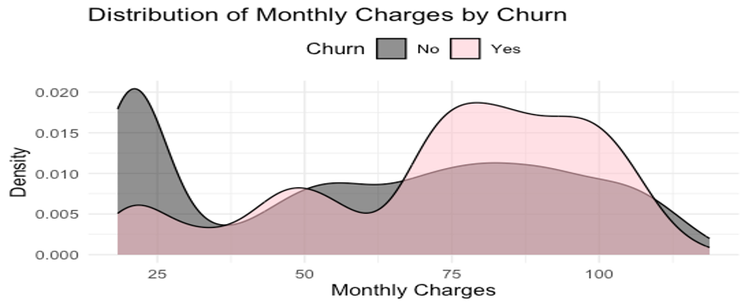
Phone Service and Churn Behavior
Almost all customers have opted for Phone Service, indicating its high demand and ubiquity in the customer base.
Churn rates do not show a strong dependency on whether the customer has Phone Service, as almost all churners belong to the group with Phone Service.
Phone Service does not significantly impact churn rates, as almost all customers opt for it. Focus should instead be placed on other features like Internet Service or additional services to identify churn drivers.
Impact of Monthly Charges on Churn
Customers with higher Monthly Charges (above $75) exhibit increased churn rates, as seen from the density of churners (pink curve) in this range.
Customers with lower Monthly Charges (below $25) are less likely to churn, as churners are almost absent in this range.
High Monthly Charges are a significant factor contributing to churn. Offering discounts or customized plans for customers with higher charges can help reduce churn.

Slide 22
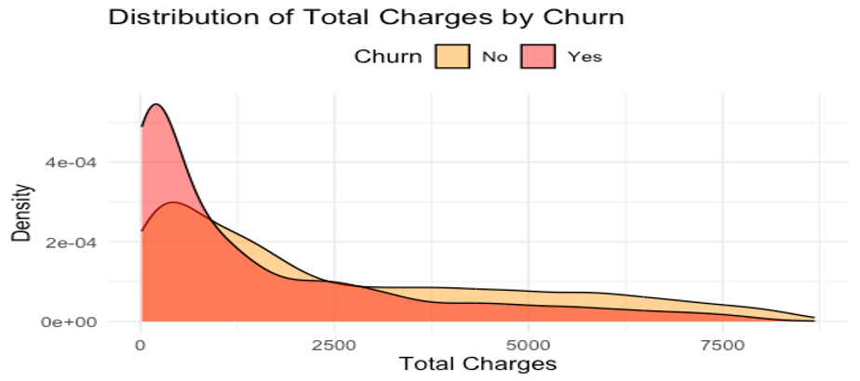
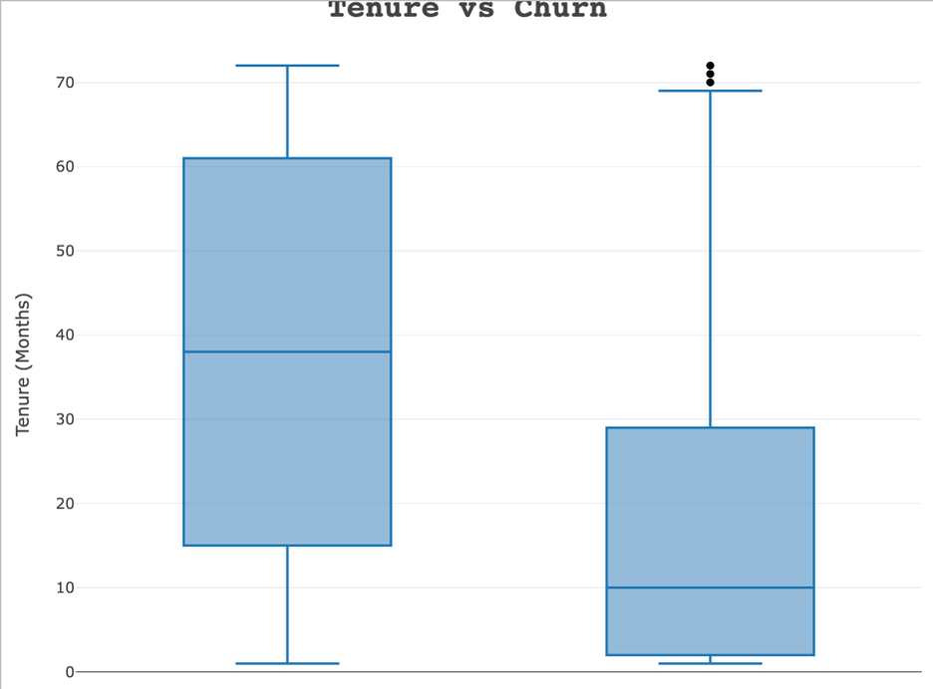
Churn Trends Based on Total Charges
Customers with low Total Charges (near $0–$1000) are more likely to churn, as indicated by the peak of the churn density curve (pink).
Customers with higher Total Charges (above $2500) show significantly lower churn rates, suggesting long-term or higher-paying customers are more loyal.
Customers with lower Total Charges (likely newer customers) are more prone to churn. Strengthening onboarding processes and offering incentives for early-stage customers can help reduce churn.
Tenure's Impact on Churn Behavior
Customers who churn tend to have significantly shorter tenures (most below 20 months) compared to those who stay.
Customers with longer tenures (above 40 months) are far less likely to churn, indicating loyalty grows with time.
Short-tenure customers are more likely to churn. Improving early customer experiences and retention strategies for new customers can significantly reduce churn rates.

Slide 23
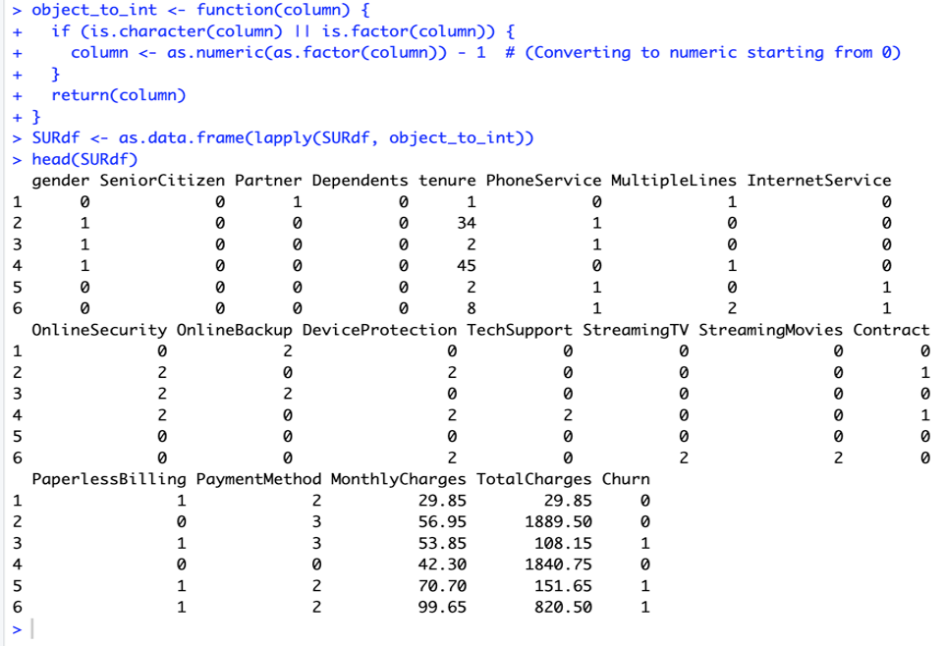
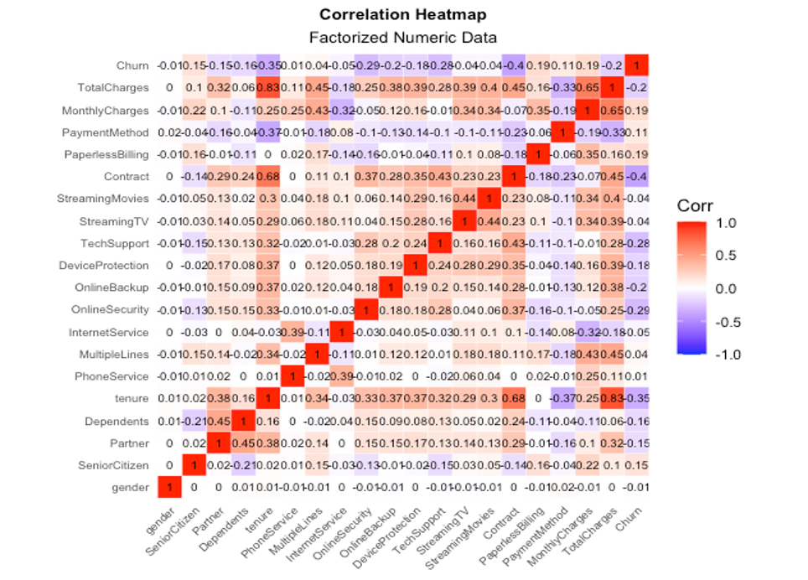
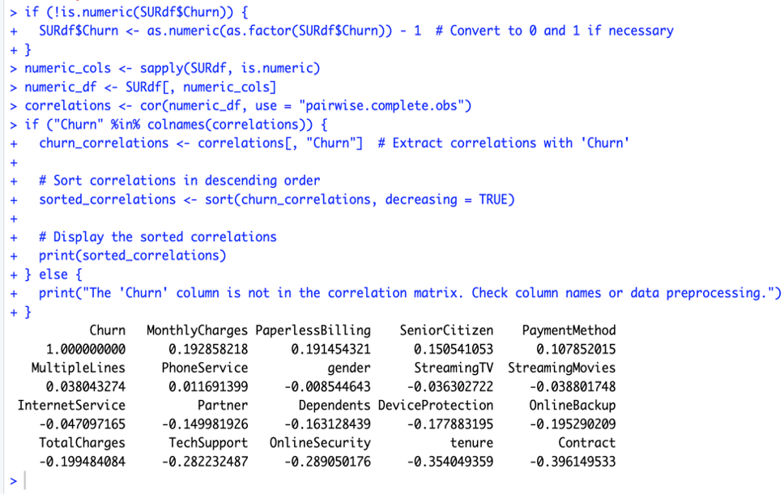
Correlation Analysis of Churn and Features
Tenure and Total Charges show a strong positive correlation (0.83), indicating that customers with longer tenure naturally accumulate higher charges.
Contract type has a significant negative correlation with churn (-0.45), meaning customers with longer contracts are less likely to churn.
Features such as contract type, tech support, and online security are strong predictors of churn, while demographic attributes like gender and age have little impact. Focus on enhancing service-related features to improve retention.

Slide 24
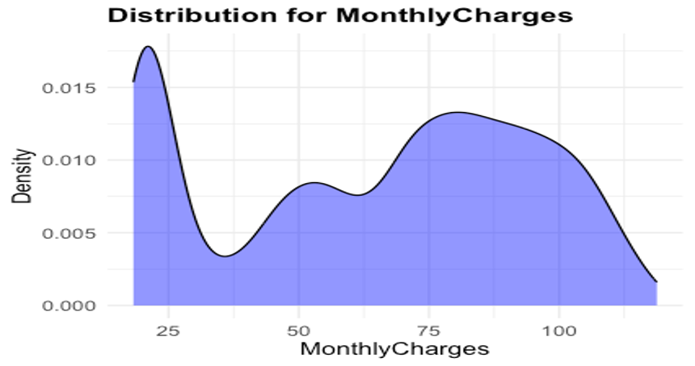
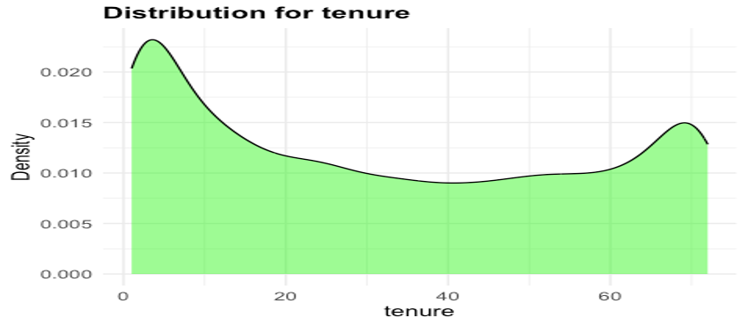
Customer Distribution by Monthly Charges
Most customers fall in the mid-range of Monthly Charges (around $50–$75), representing a significant portion of the customer base.
There is a notable density of customers in the lower charge range (below $25), likely representing basic plans or minimal service usage.
The majority of customers are concentrated in mid-range charges, with fewer customers opting for premium plans. Strategies to upsell mid-range customers and attract low-charge customers to higher tiers could enhance revenue.
Tenure Distribution and Customer Behavior
A significant number of customers have very short tenures (close to 0–10 months), indicating a large proportion of new or recently acquired customers.
The density of customers in the mid-tenure range (20–50 months) is relatively low, suggesting potential drop-offs during this period.
The distribution highlights two key customer groups: new customers with high churn risk and long-tenure customers with higher loyalty. Strengthening engagement during the mid-tenure period may help retain customers and move them into the loyal segment.

Slide 25
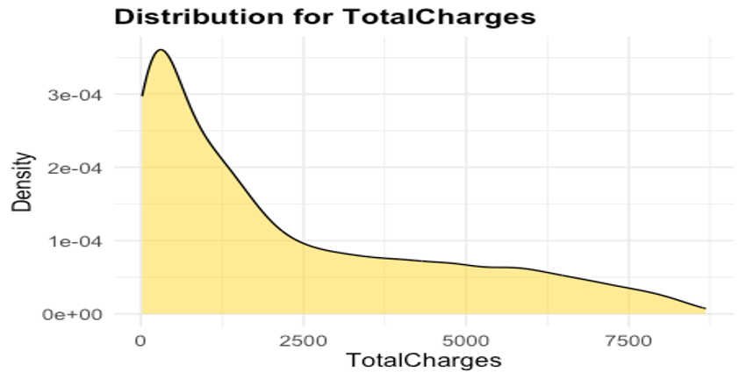
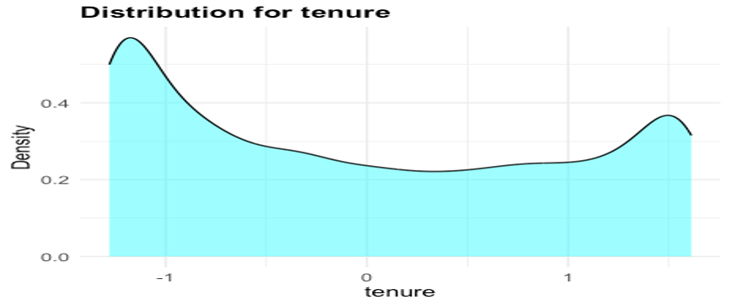
Total Charges Distribution and Customer Segments
The majority of customers are concentrated at low Total Charges (close to $0–$1000), likely representing new or short-tenure customers.
The density decreases consistently as Total Charges increase, suggesting fewer customers have high cumulative spending over time.
Total Charges are highly skewed, with most customers in the low-charge category, indicating a large base of new or less-engaged customers. Increasing engagement and upselling strategies could move more customers into the higher spending category over time.
Scaled Tenure Distribution and Customer Behavior
The tenure distribution shows a high density in the negative range, indicating that many customers are in the lower tenure group after scaling. This corresponds to shorter-tenure customers.
The mid-range tenure values (centered around 0) have a lower density, suggesting a drop in customers retained for intermediate time periods.
The scaled tenure distribution highlights a large group of short-tenure customers and a smaller loyal segment with longer tenures. Retention strategies should focus on bridging the gap in mid-tenure customers to move them into the loyal segment.

Slide 26
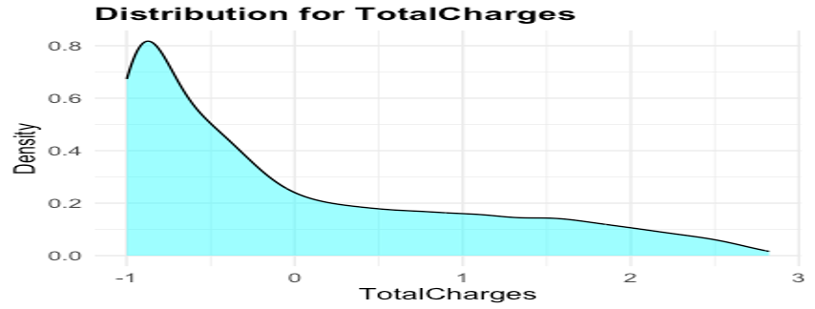
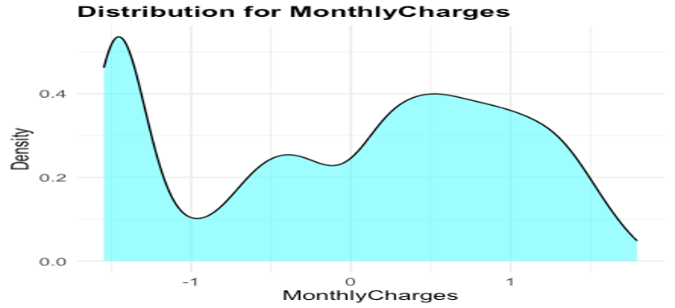
Scaled Total Charges Distribution
The highest density is observed at negative scale values, indicating that most customers have low Total Charges after scaling. This aligns with customers who are new or have had minimal engagement.
As scaled Total Charges increase towards positive values, the density steadily decreases, suggesting fewer customers have high cumulative spending.
The scaled Total Charges reveal a skewed distribution, with most customers in the low-charge group. Strategies to move low-charge customers into higher brackets through engagement and upselling are crucial for revenue growth.
Scaled Monthly Charges Distribution
The peak at negative scaled values indicates that a majority of customers are paying lower monthly charges.
There is a relatively even distribution around the center (scaled value of 0), indicating customers in the mid-range of monthly charges are more evenly spread.
The scaled Monthly Charges distribution indicates a majority of customers in the low-charge segment, with opportunities to push mid-range customers towards higher-value plans. Segmenting and targeting the low and mid-range groups with customized offers may improve revenue.

Slide 27

STAGE - 3

Slide 28
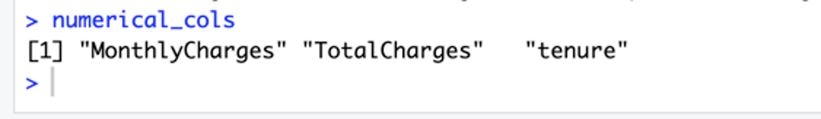
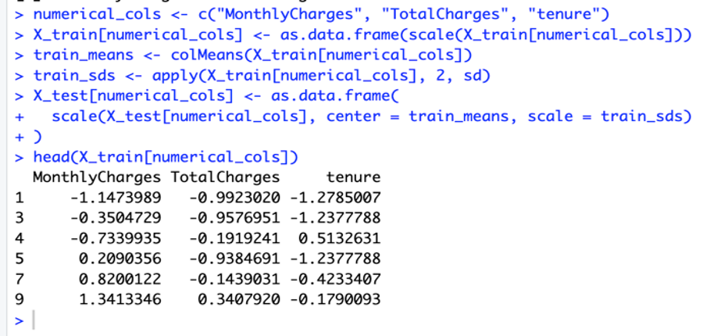
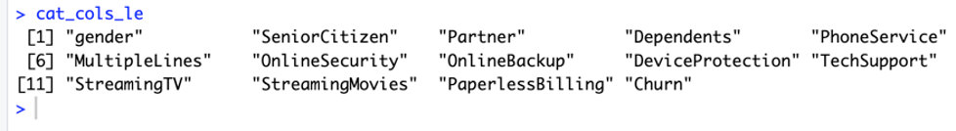
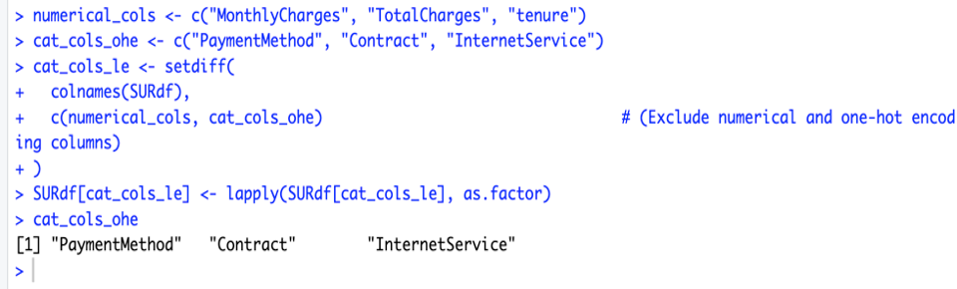
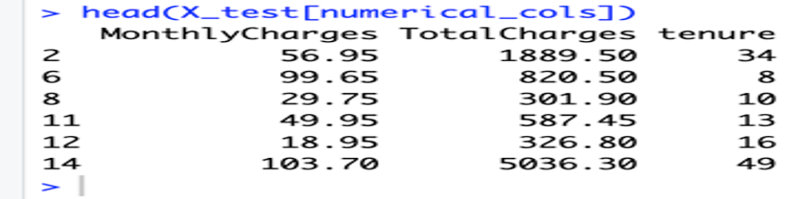
Data Scaling
Label Encoding
One Hot Encoding

Slide 29

STAGE - 4

Slide 30


K-Nearest Neighbors Model Performance
The KNN model uses 11 neighbors (k = 11) for classification, indicating reliance on a broader neighborhood for decision-making.
The KNN model achieved an accuracy of 72.83%, signifying its ability to correctly classify approximately 73% of the test data.
The KNN model achieves an accuracy of ~73% with k=11, highlighting a fair classification performance.
KNN Confusion Matrix Analysis
The model predicts all instances as '0' (non-churn) and fails to classify any instance as '1' (churn), leading to a sensitivity of 1.0 (perfect recall for class '0') but specificity of 0.0.
Positive Predictive Value (PPV) or Precision for class '0' is 72.83%.There is no specificity or valid negative predictive value (NPV) for class '1’.
Kappa score is 0, indicating that the model's predictions do not improve over random chance when considering the imbalance in the dataset.
The model is biased towards the dominant class ('0'), suggesting that class imbalance is a significant issue affecting the KNN performance.

Slide 31


Random Forest Model: OOB Evaluation
The OOB score of the Random Forest model is 0.25 (25.47%), which indicates that the model performs poorly on unseen (out-of-bag) data.
500 trees were used in the forest, which should be sufficient for convergence.The number of features considered at each split (mtry) is set to the square root of the total features, which is a recommended heuristic.
The sampsize parameter ensures balanced sampling of the two classes, addressing class imbalance to some extent.
The Random Forest model's OOB score of 25.47% indicates significant underfitting. This might be due to overly restrictive hyperparameters (e.g., max nodes).
Random Forest Model: Test Accuracy
The Random Forest model achieved an accuracy of 77.19% on the test set.
There is a significant improvement compared to the earlier Out-of-Bag (OOB) score of 25.47%. This suggests that the model generalizes better on unseen test data than on its OOB data during training.
The model's ability to handle imbalanced data through stratified sampling has likely contributed to this improved accuracy.
The Random Forest model achieved a moderate accuracy of 77.19% on the test set, indicating it is fairly effective in predicting churn.

Slide 32


Random Forest Model: Performance Evaluation
The model achieved an accuracy of 77.19%, indicating a moderately good performance in predicting customer churn.
84.96%: The model is highly effective in correctly identifying non-churn customers (Class 0).
56.37%: The ability to correctly identify churn customers (Class 1) is relatively weaker compared to non-churn customers, highlighting an area for improvement.
When the model predicts non-churn, it's correct 83.92% of the time.
Random Forest ROC Curve
The ROC curve demonstrates a good separation between true positive and false positive rates. The curve rises steeply initially, indicating that the Random Forest model effectively distinguishes between churn and non-churn customers at lower false positive rates.
The curve is significantly above the diagonal baseline, which suggests that the model performs better than random guessing. A high AUC value (likely around 0.8 based on the shape) signifies strong predictive power.
The curve's shape indicates a well-balanced trade-off between sensitivity (true positive rate) and specificity (false positive rate).
The Random Forest model shows robust classification capability, as evidenced by the high AUC value in the ROC curve.

Slide 33


Logistic Regression
(Data Preprocessing and Class Distribution)
The training data (y_train) exhibits a class imbalance with 3,627 samples for class 0 (non-churn) and 1,296 samples for class 1 (churn).Class 0 (non-churn) accounts for approximately 73.7% of the training data, while class 1 (churn) accounts for 26.3%.
The features in X_train and X_test have been scaled, ensuring that numerical features are normalized for better model performance.
The training dataset is imbalanced, with a higher proportion of non-churn customers. Addressing this imbalance during model training is critical to ensure fair and accurate predictions for churn.
Handling Imbalance and Regularized Logistic Regression
Oversampling has been performed using the ROSE package to balance the dataset.The ovun.sample method increased the size of the minority class (Churn = 1) to match the majority class (Churn = 0), creating a balanced training set.
Logistic regression with L2 regularization (Ridge regression) was applied to the balanced dataset to avoid overfitting and improve model generalization.
Cross-validation with 10 folds (nfolds = 10) was used to find the optimal lambda (regularization parameter).The best lambda value identified is 0.0242553634509758, which balances the trade-off between bias and variance.

Slide 34


Regularized Logistic Regression Results
A logistic regression model was trained using the best lambda identified from cross-validation (lambda = 0.024), ensuring optimal regularization for generalization.
Predictions were made on the test set using the trained model, with a decision threshold of 0.5 to classify outcomes.
The final logistic regression model achieved an accuracy of 69.99% on the test set, indicating a fair performance with room for improvement.
The regularized logistic regression model performed moderately well with a nearly 70% accuracy, indicating the balanced dataset and regularization positively impacted predictions.
Logistic Regression Model Performance
The logistic regression model achieved an accuracy of 69.99%, indicating moderate predictive performance.
For churners: 93.37% – The model predicts churn accurately for the majority of cases.
The balanced accuracy is 75.62%, reflecting an average of sensitivity and specificity, suggesting reasonable performance in handling both churners and non-churners.
Kappa: 0.4032 – This indicates fair agreement between the predicted and actual classes beyond chance.

Slide 35


Confusion Matrix: Logistic Regression
The model struggles more with identifying customers who churn (high False Negatives).
False Positive count is also substantial, suggesting misclassification for non-churners.
The logistic regression model performs well in detecting churned customers but suffers from a significant number of false negatives, making it less reliable in identifying churners.
Logistic Regression: ROC Curve
The ROC curve demonstrates the trade-off between the true positive rate (TPR) and false positive rate (FPR) across different threshold values.
The curve indicates a fair model performance, as it rises significantly above the diagonal random guess line.
The model shows improved TPR (True Positive Rate) at higher thresholds.
There is room for improvement in distinguishing churners from non-churners more effectively at lower FPR values.

Slide 36


Decision Tree Model Performance
The decision tree classifier achieved an accuracy of 72.83% on the test data, indicating moderate performance in predicting customer churn.
Decision Tree Classification Report
Sensitivity (Recall for Class 0): Perfect at 1.0000, meaning the model identified all non-churn customers correctly.Specificity (Recall for Class 1): 0.0000, indicating the model failed to correctly identify any churn customers.
The Kappa value is 0, suggesting the model's predictions are no better than random guessing when considering class imbalance.
Predicted all cases as non-churn (Class 0), leading to:
Correctly predicted 1,536 non-churn instances.
Misclassified all 573 churn instances as non-churn.

Slide 37


AdaBoost-Like Model Performance
The AdaBoost-like model achieved an accuracy of 74.82%, indicating a reasonable performance in predicting both churn and non-churn customers.
The model demonstrates better handling of the imbalanced data compared to simpler models like Decision Tree, showcasing its ensemble capability.
AdaBoost-Like Model Classification Report
High sensitivity (98.83%) indicates that the model effectively identifies true positives (correctly classifying non-churn cases).
Low specificity (10.47%) suggests that the model struggles with correctly identifying true negatives (churn cases).
Positive predictive value (PPV) of 74.74% demonstrates a decent proportion of correctly predicted churn cases among all predicted churn cases.
A balanced accuracy of 54.65% reflects a slight imbalance in the model's classification ability for both churn and non-churn cases.

Slide 38

XGBoost Confusion Matrix Analysis
True Positives: 513 churn cases correctly classified.
False Positives: Only 18 non-churn cases misclassified as churn.
True Negatives: Moderate performance with 60 non-churn cases correctly predicted.
False Negatives: High count (1518) of churn cases misclassified as non-churn.
The model's imbalance between precision and recall indicates the need for enhanced tuning or data preprocessing to better identify churn cases.
FINAL CONCLUSION
We moved forward with Random Forest that achieved the highest accuracy (77.19%) among the tested models, with balanced precision and recall compared to others.
BUSINESS INSIGHTS
Most churners prefer Month-to-Month Contracts. Introduce discounts or incentives to convert them to longer-term contracts (e.g., annual plans).
Customers with No Online Security or Tech Support: Offer bundled packages that include these services to increase retention.
High Monthly Charges: Customers paying higher monthly fees have a higher churn rate. Implement loyalty discounts or flexible payment plans to retain these customers.
Use data insights to send personalized offers based on customer preferences and behavior, such as discounts for services they frequently use.
Provide customized communication plans targeting seniors and non-partnered individuals, who churn more frequently.
New customers (low tenure) are more likely to churn. Develop onboarding programs and offer exclusive benefits during the first year.

Slide 39
THANK YOU…
Surya vamsi

